Slide 1

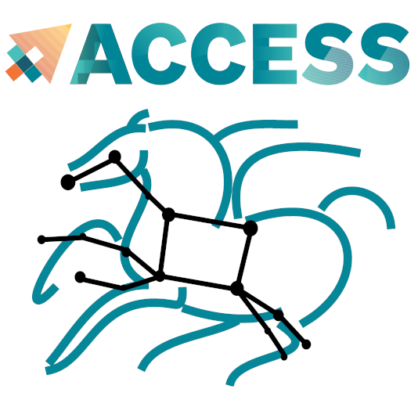
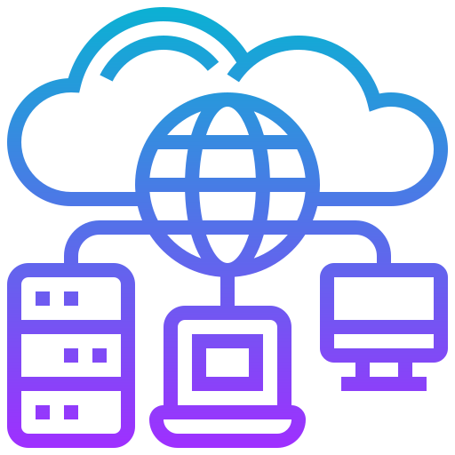
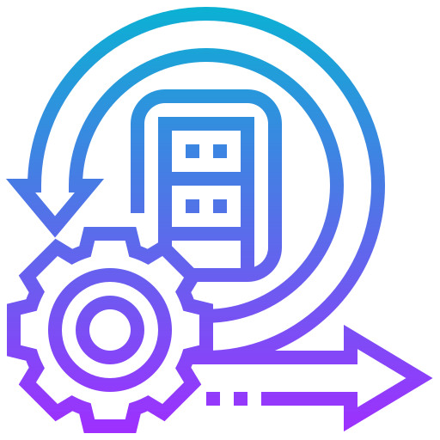
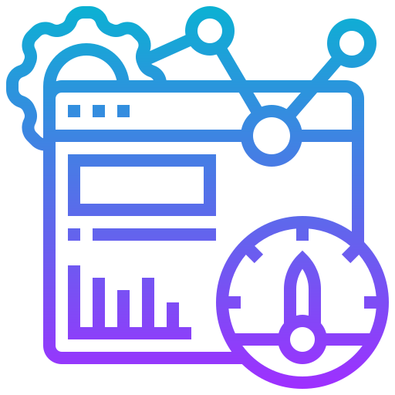
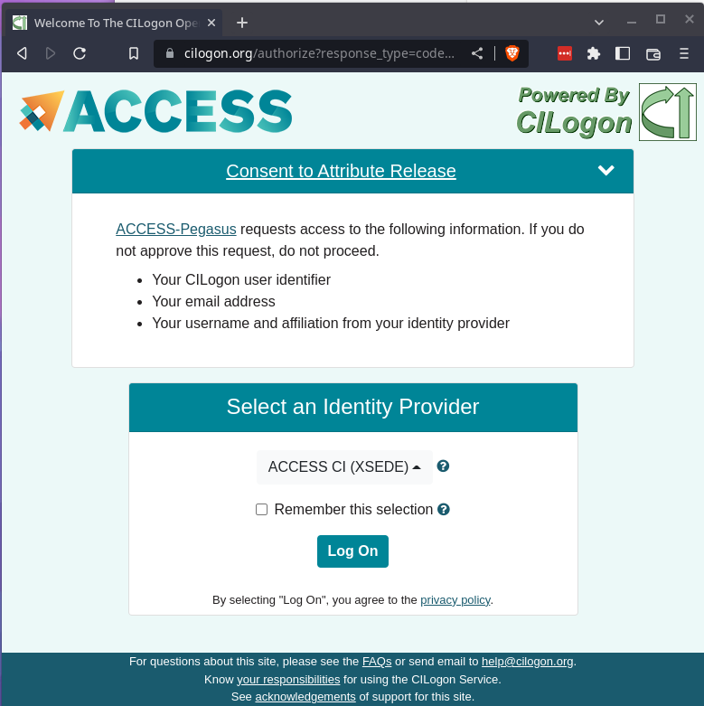
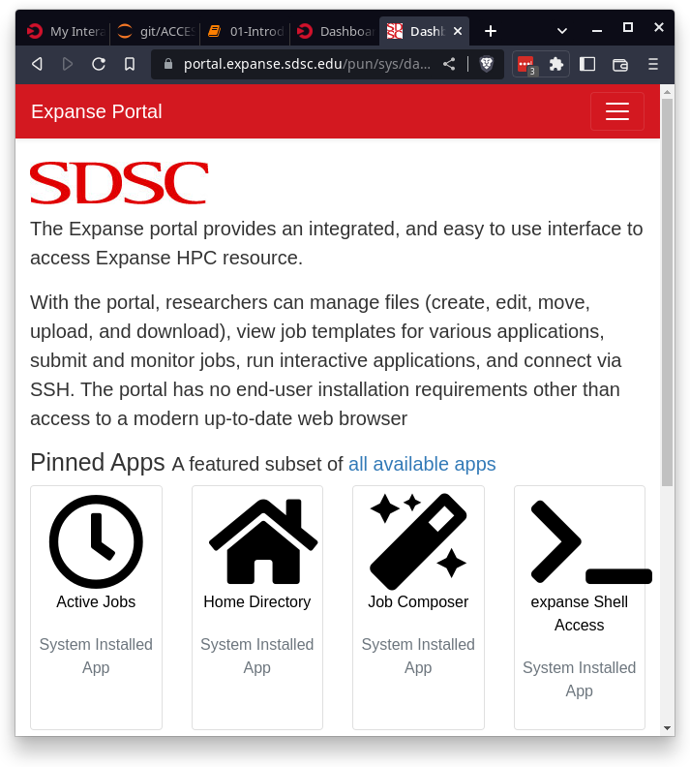

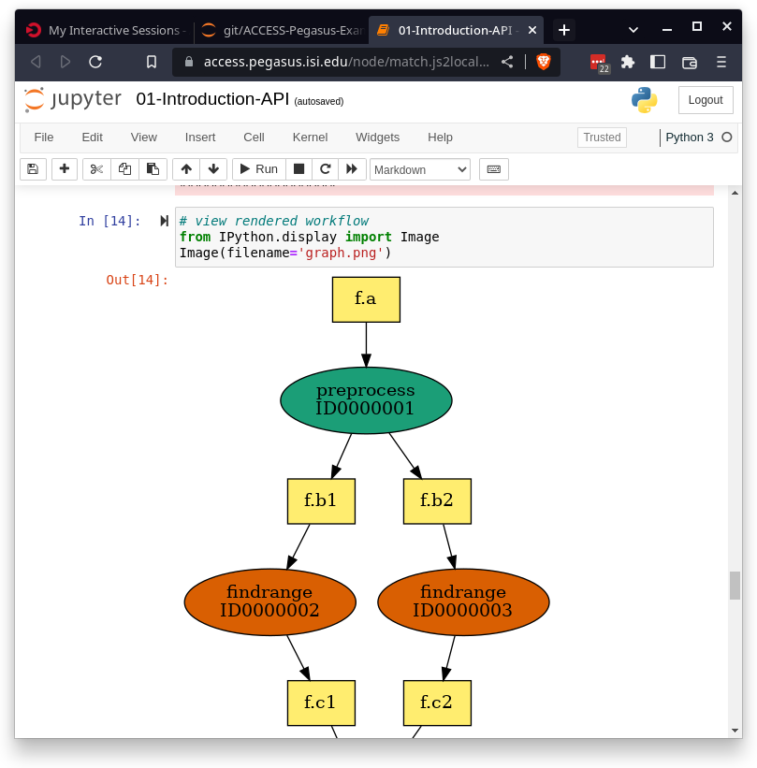
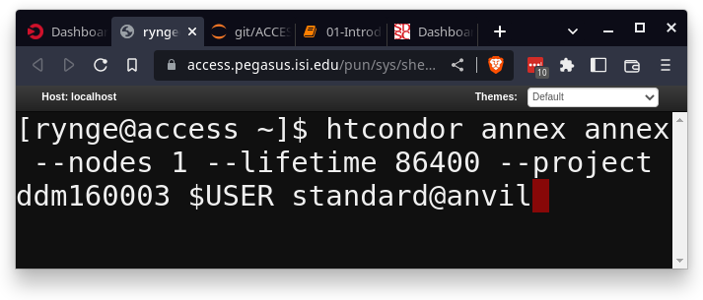
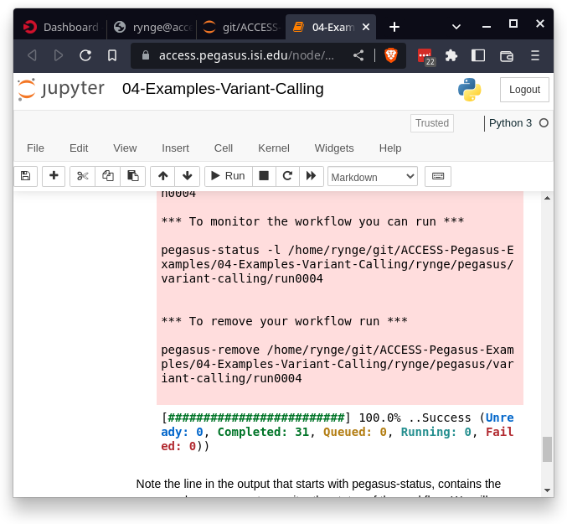
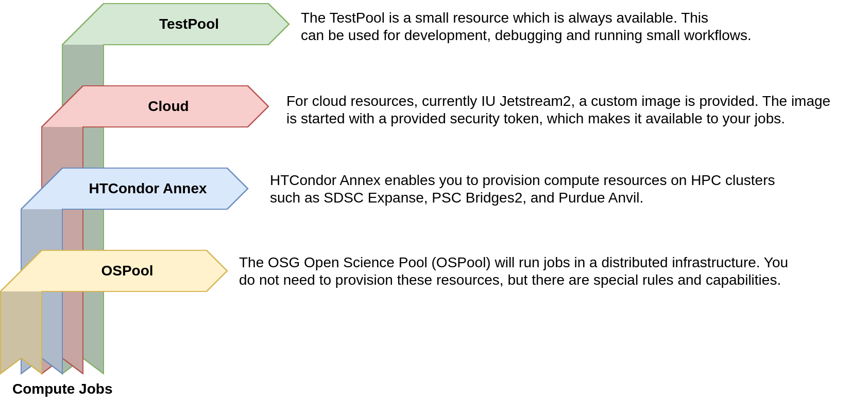
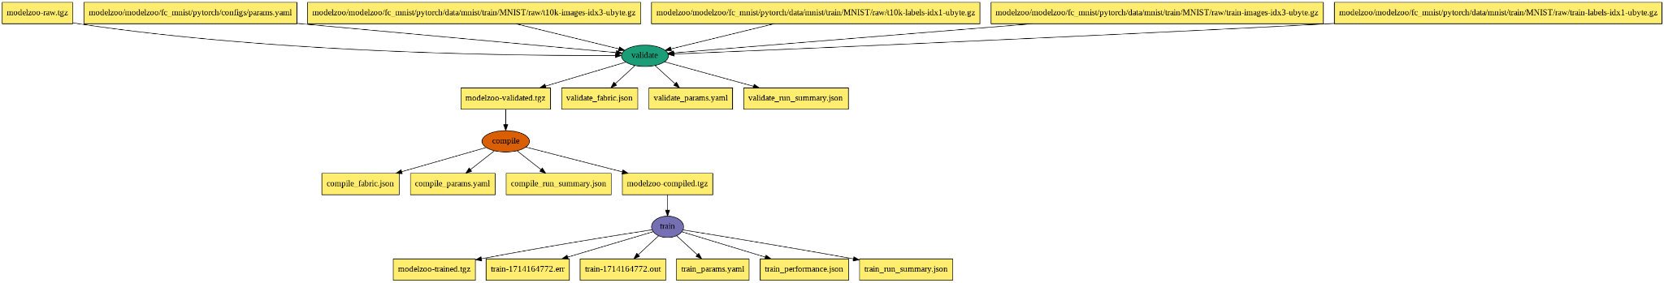
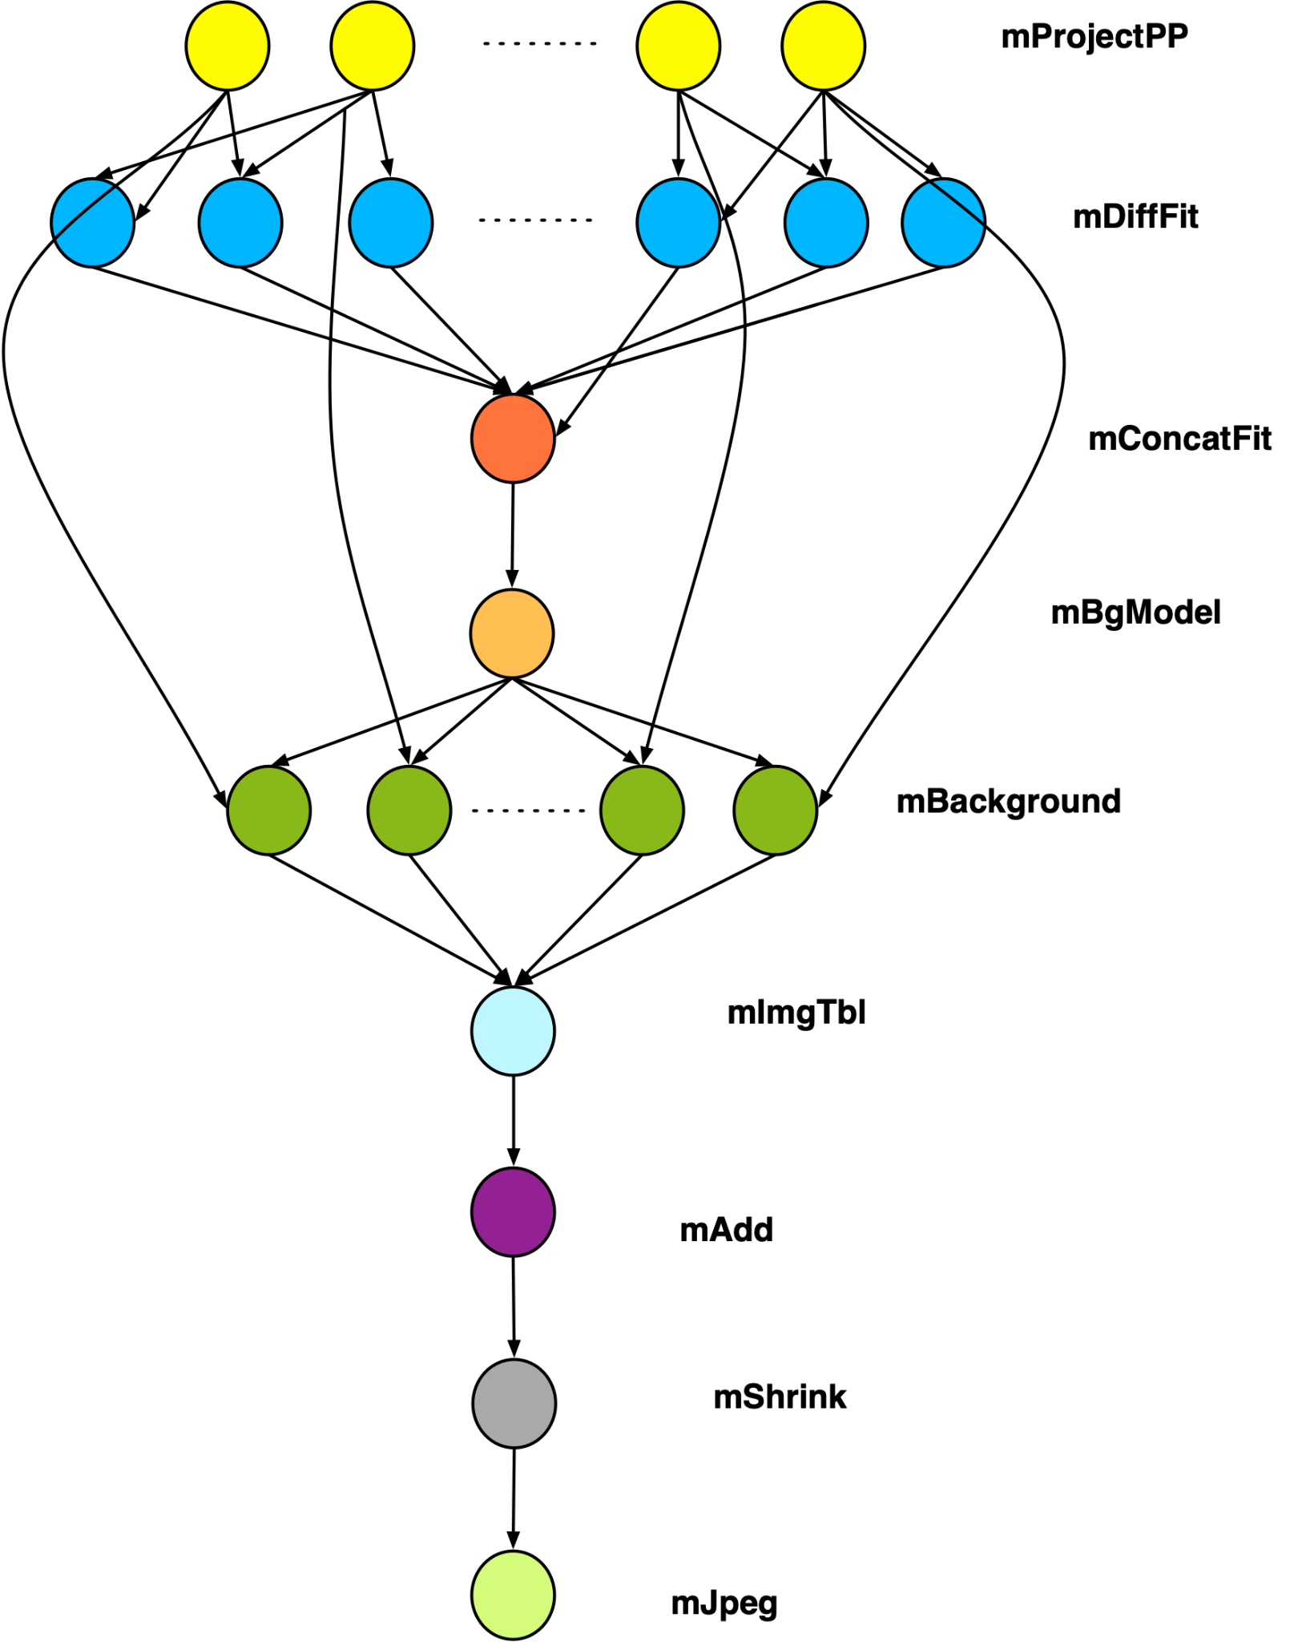
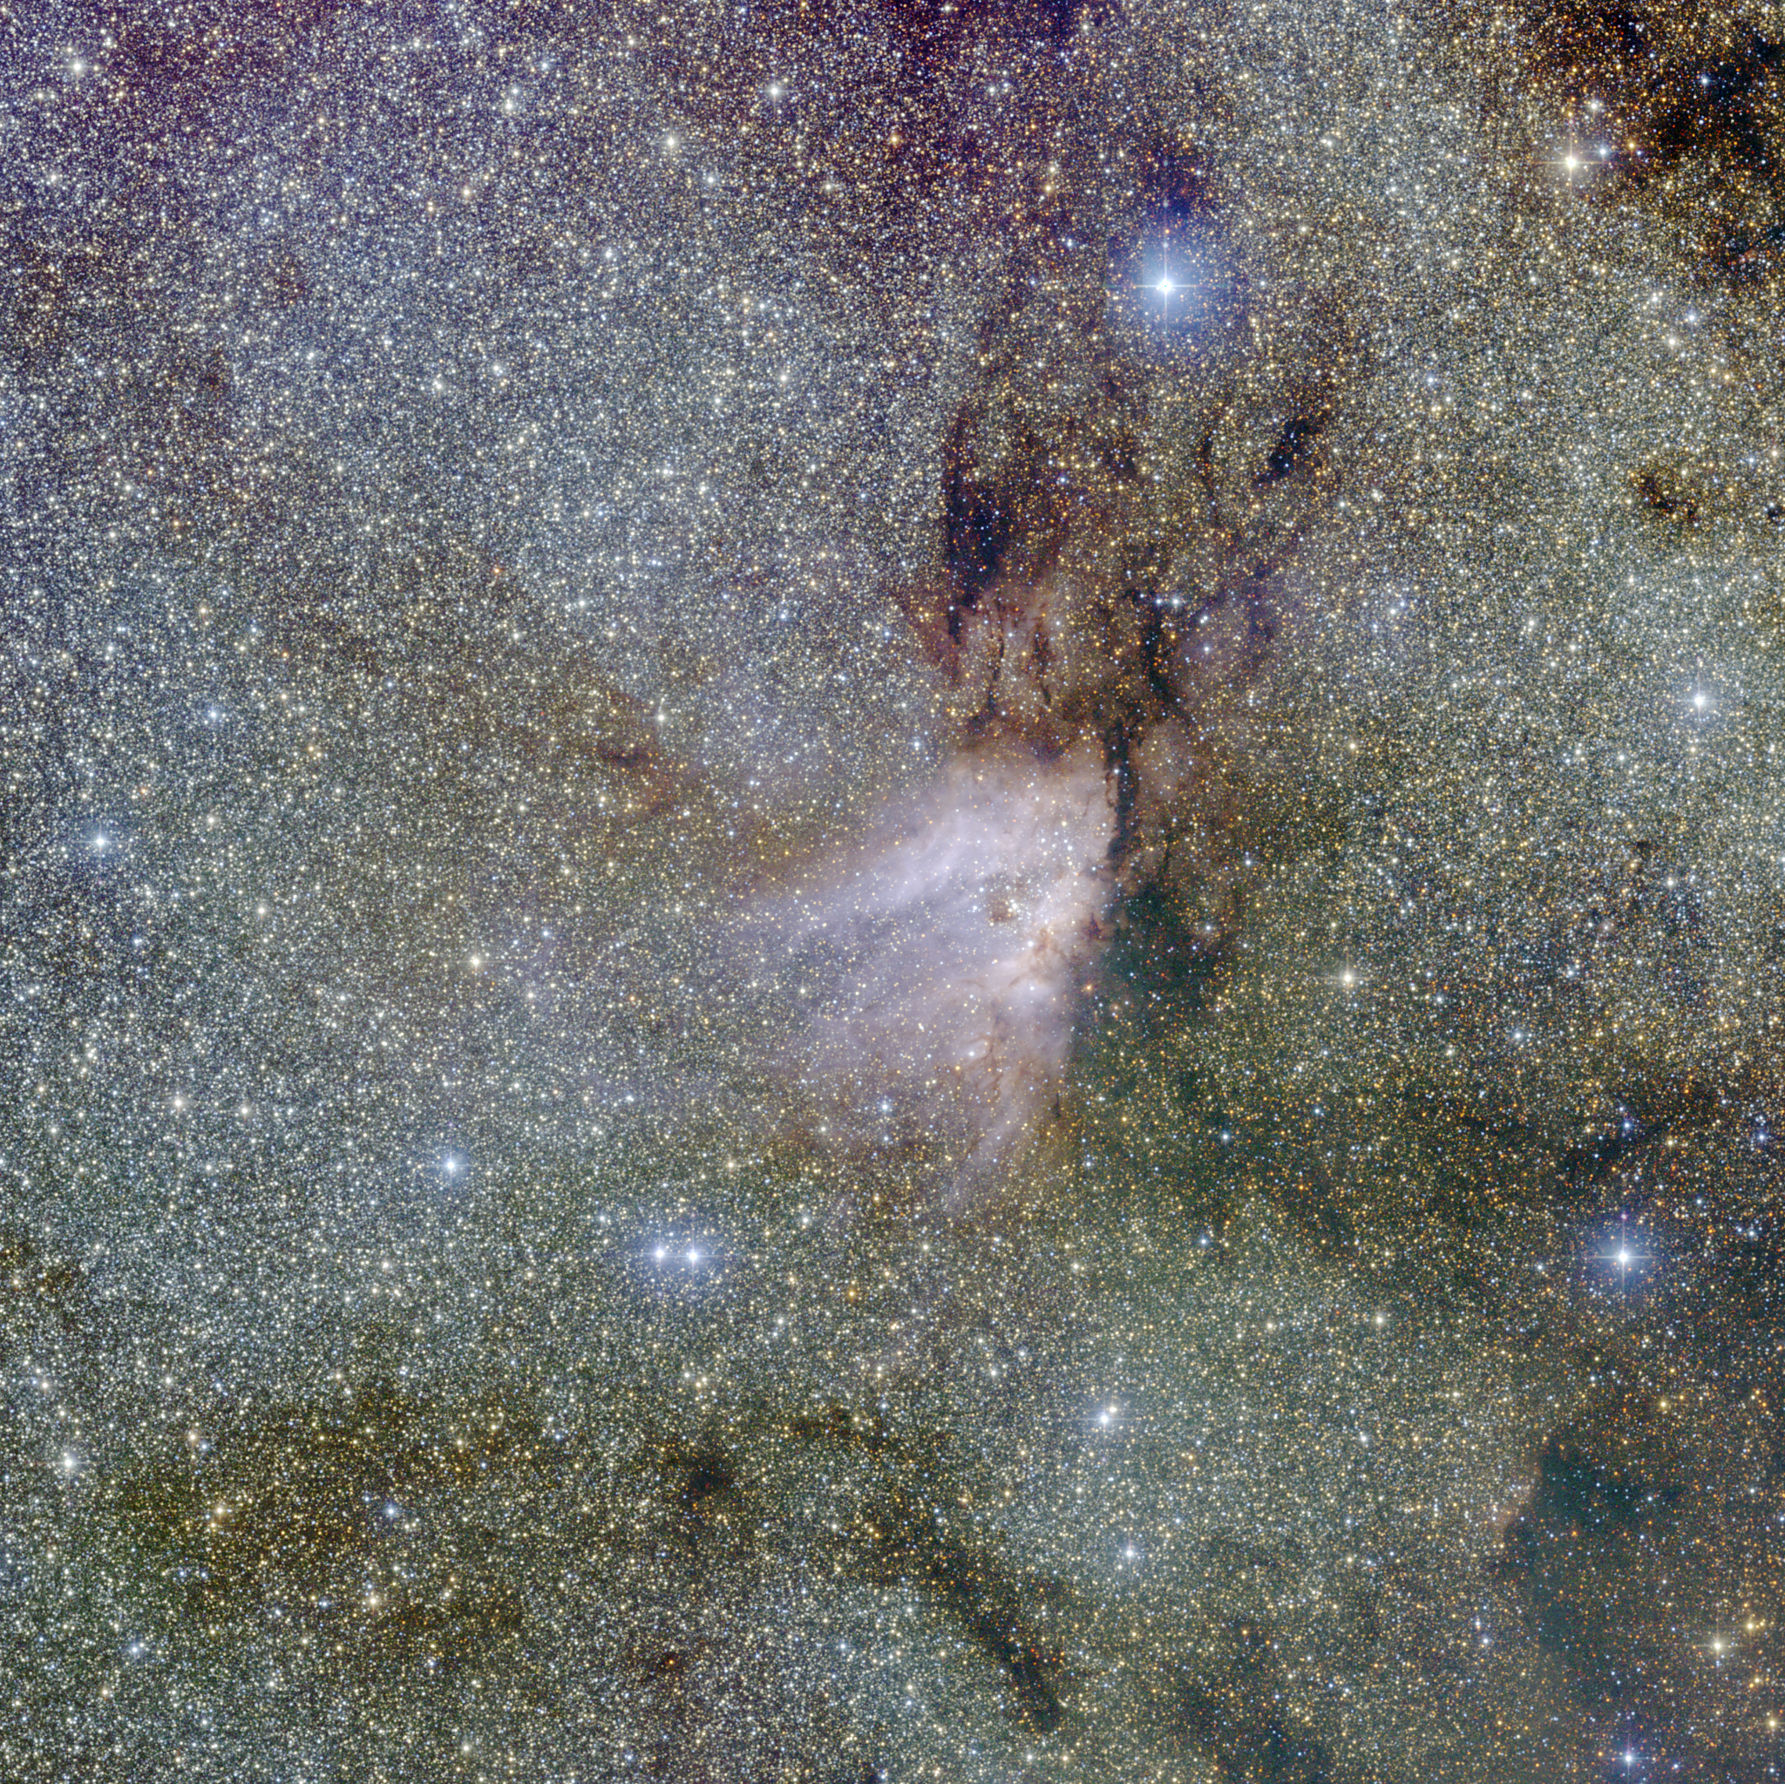
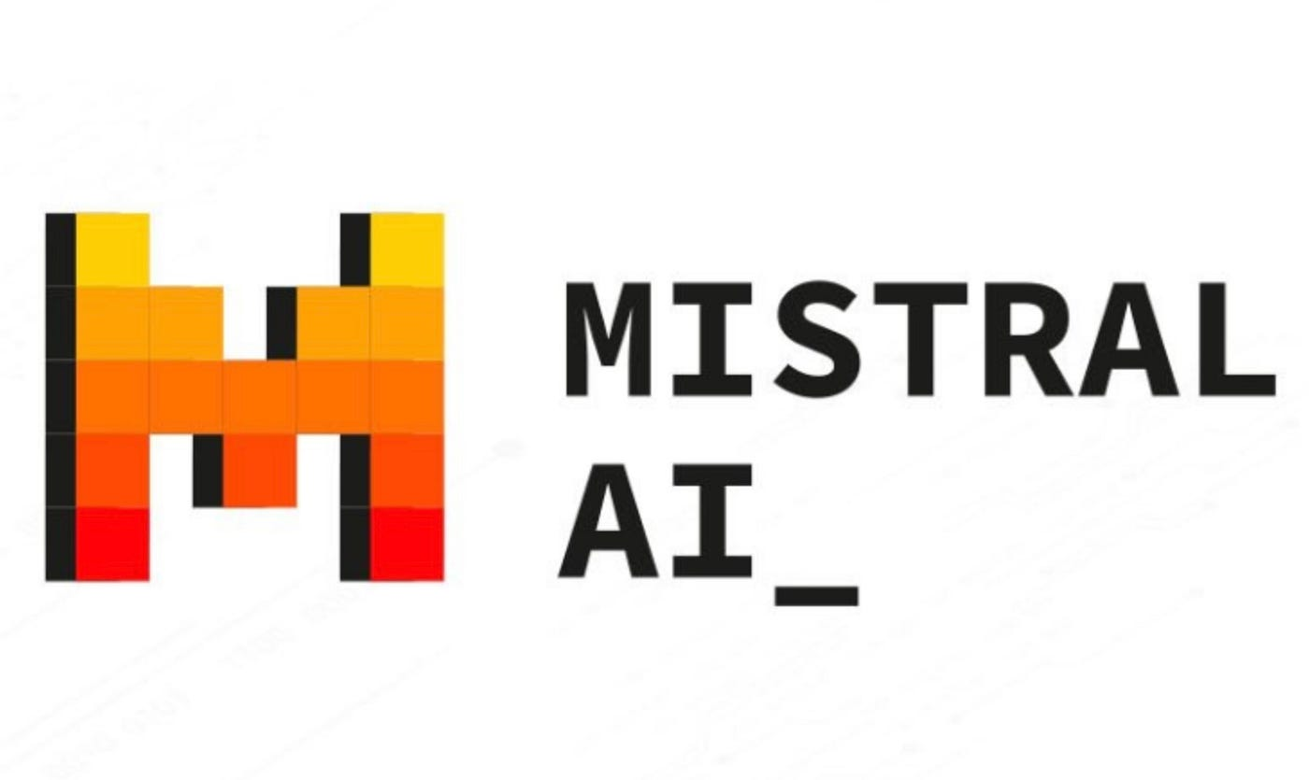
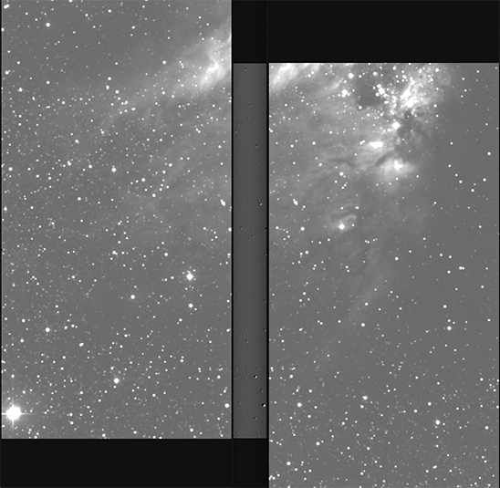
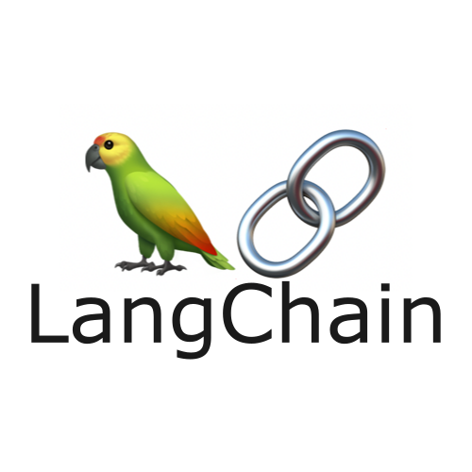
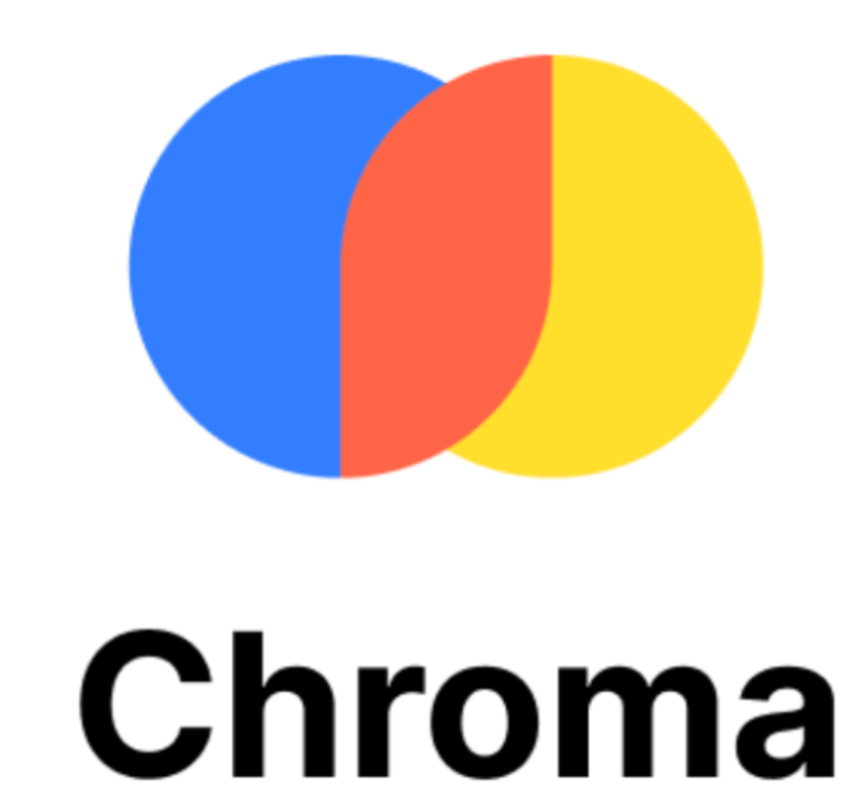
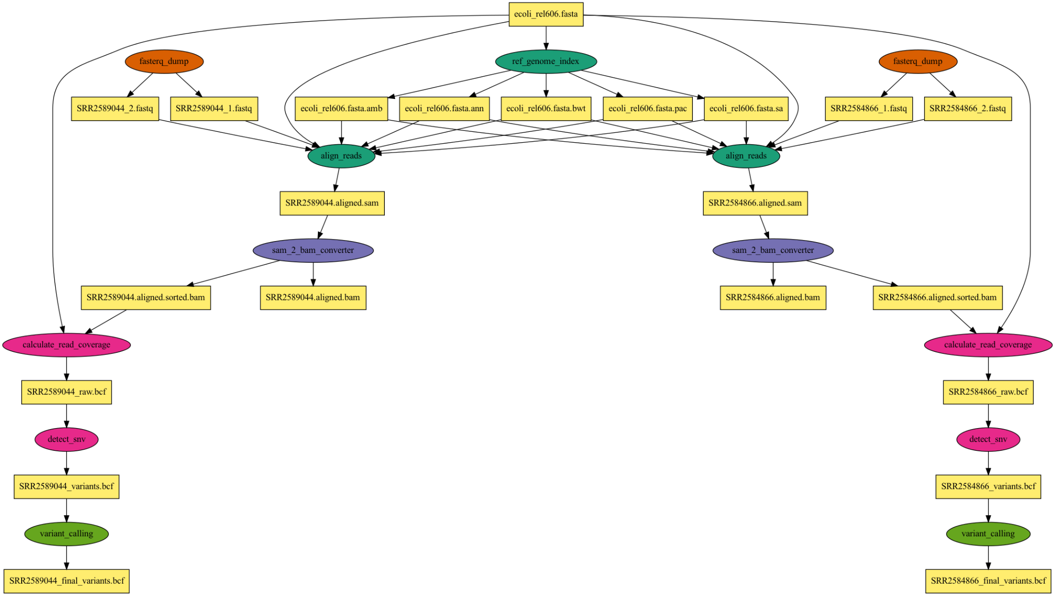
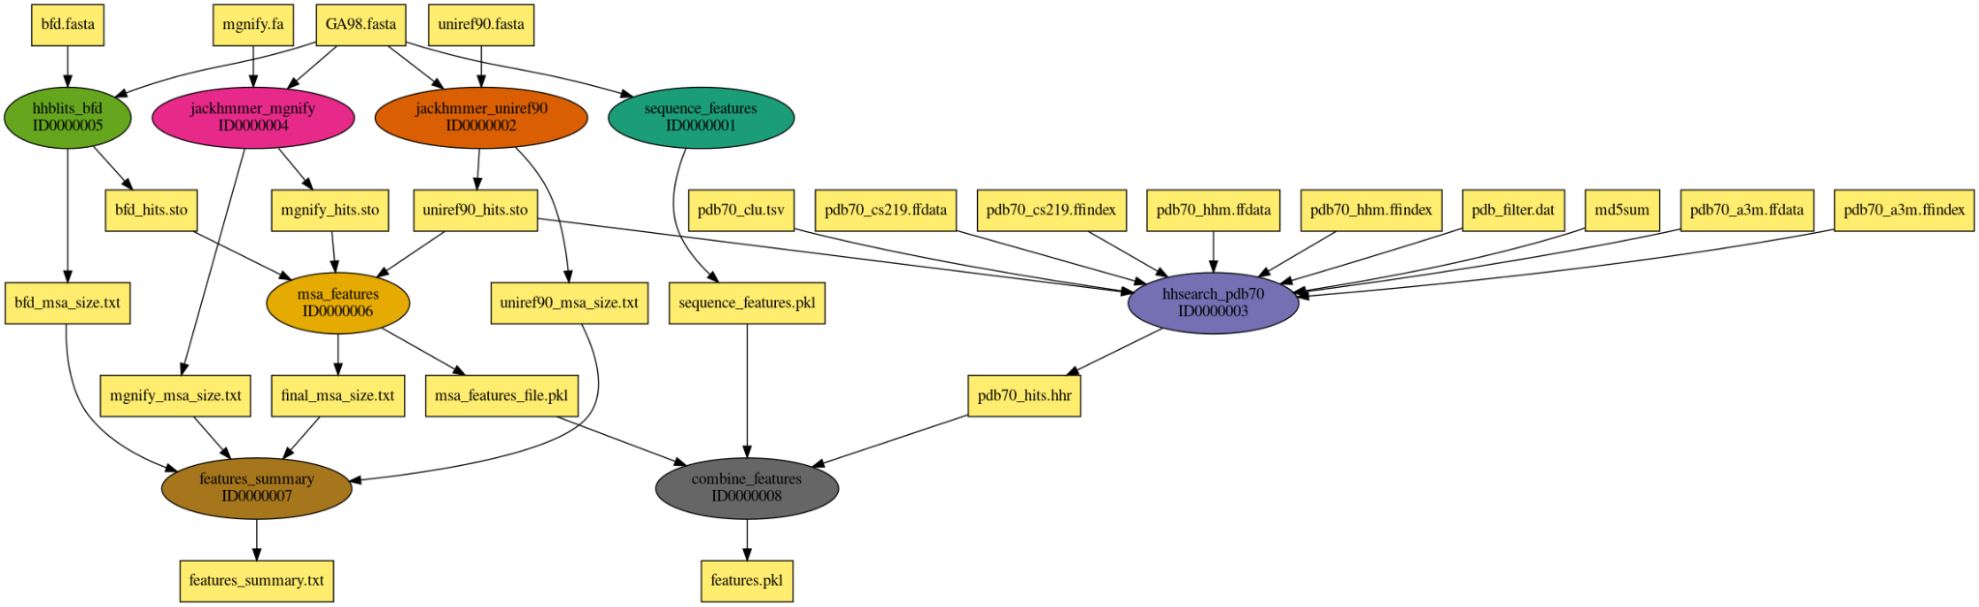
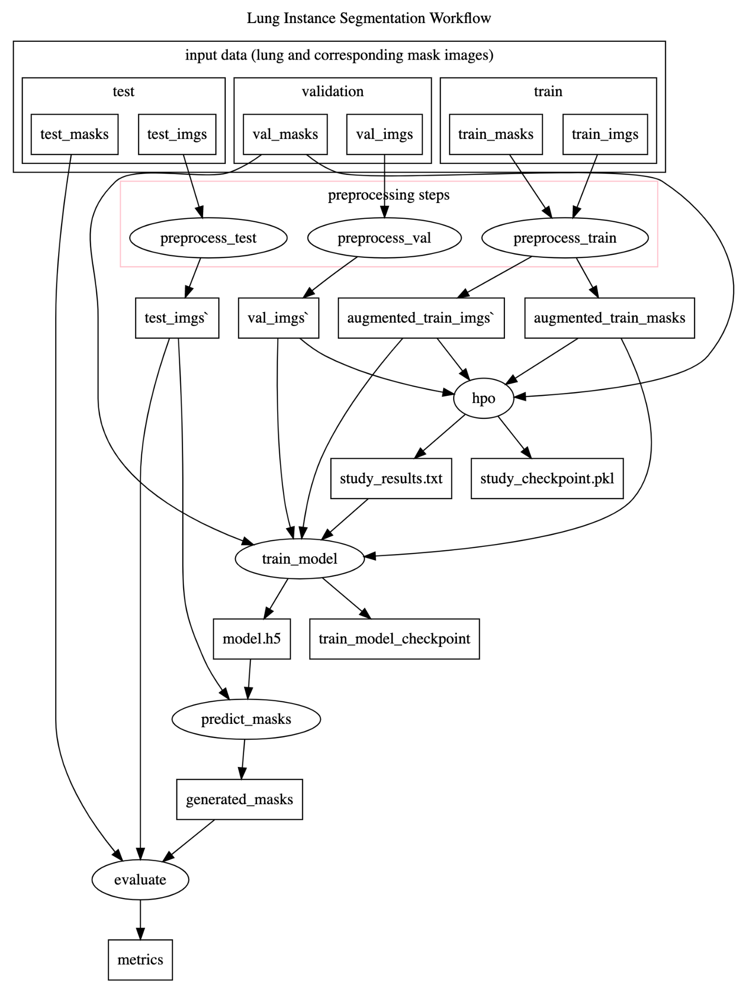
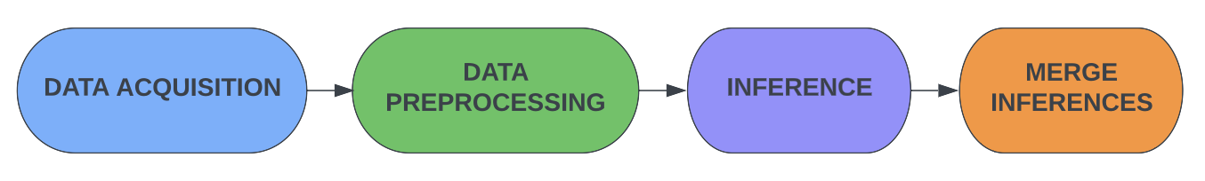
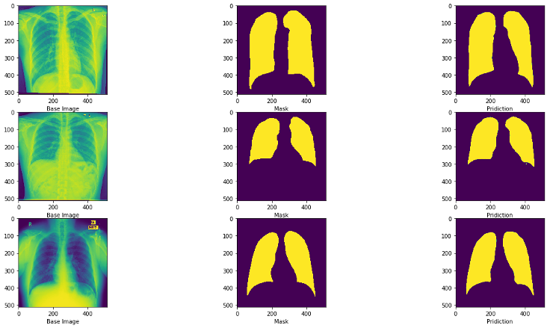
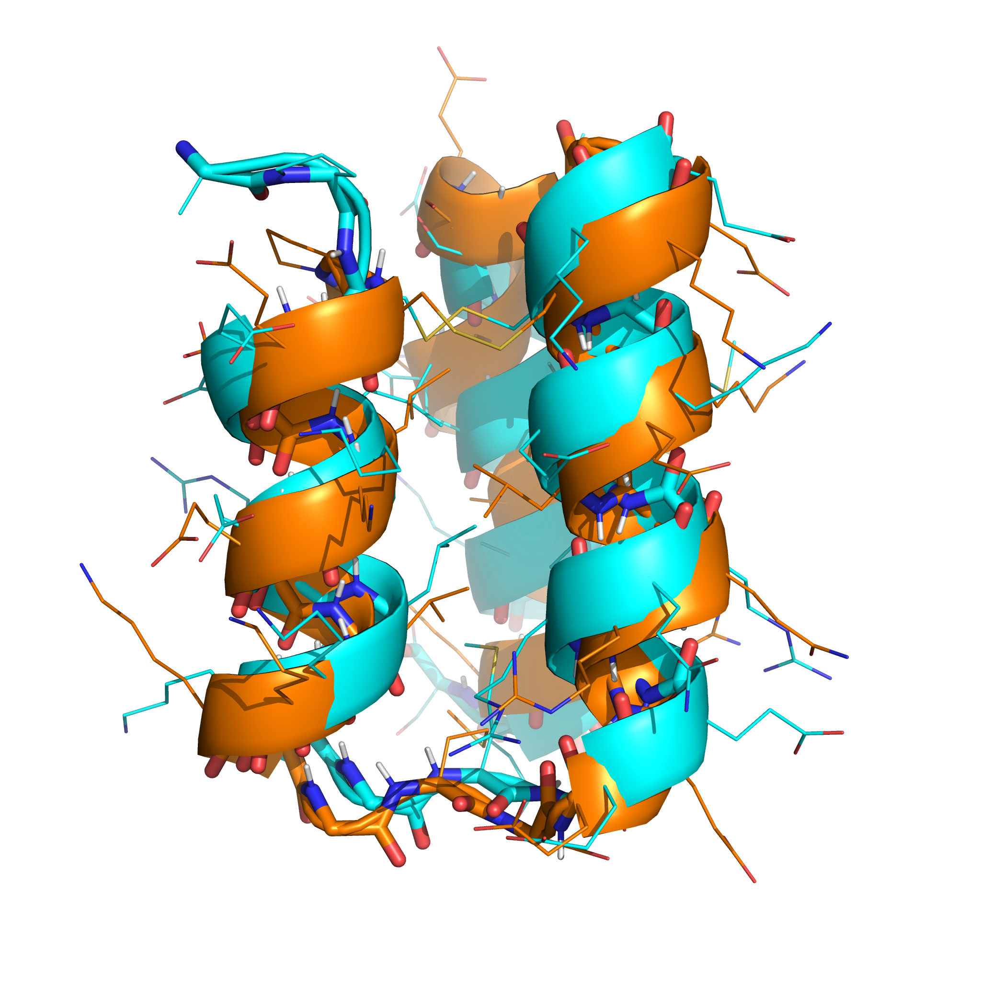
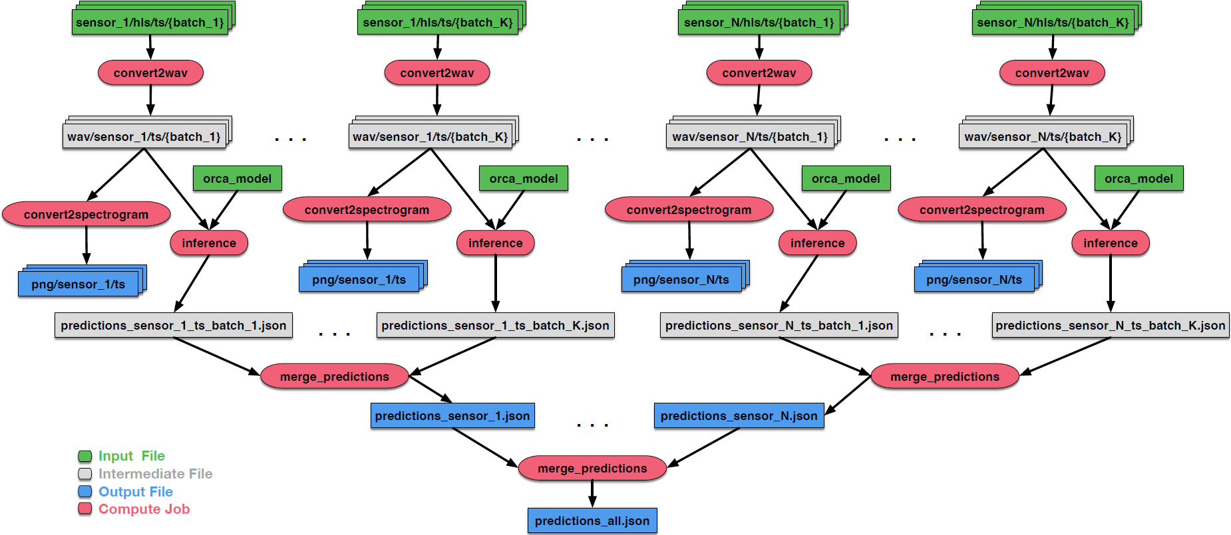



ACCESS Pegasus: Bringing
Workflows to the ACCESS Community
Mats Rynge¹, Karan Vahi¹, Rajiv Mayani¹, Ewa Deelman¹, Todd Miller², Miron Livny², Shelly Knuth³, Alana Romanella ³, James Griffioen⁴, John Goodhue⁵, David Hudak⁶, Andrew Pasquale⁵, Lissie Fein⁵ ¹ USC Information Sciences Institute, ²University of Wisconsin-Madison, ³ University of Colorado, ⁴ University of Kentucky, ⁵ Massachusetts Green High Performance Computing Center, ⁶ Ohio Supercomputer Center
ACCESS Pegasus is a hosted workflow management system that enables users to build, execute, and troubleshoot workflows directly from a Jupyter Notebook. It also supports easy to use command-line interactions, allowing users to provision and work efficiently across various resources provided by the ACCESS infrastructure. With its Python API and pre-configured sample workflows, getting started is fast and easy.
ACCESS Pegasus Goals
Why Pegasus for Workflows?
Provide an intuitive, accessible scientific workflow environment, catering to all user levels, with easy-to-use workflow design tools, provisioning across ACCESS resource providers, and collaborative features.
Democratize access: Broaden ACCESS to sophisticated systems and tools
Empower scientists: Enable individual users, in the same way as large-scale collaborations
Promote open science and team science: Sharing workflows is as easy as sharing Jupyter Notebooks
Promote reproducibility: Use someone else’s workflow with your data and your ACCESS allocation
Tight integration with ACCESS, and ACCESS resource providers
Heterogeneous Environments
Pegasus can execute workflows in a variety of distributed computing environments such as HPC clusters, Amazon EC2, Google Cloud, OSG OSPool or ACCESS
Data Management
Pegasus handles data transfers, input data selection and output registration by adding them as auxiliary jobs to the workflow
Provenance Tracking
Pegasus allows users to trace the history of a workflow and its outputs, including information about data sources and softwares used
Error Recovery
Pegasus handles errors by retrying tasks, workflow level checkpointing, re-mapping and alternative data sources for data staging
Account / Allocations
Pathway
1. Create the workflow
Use Pegasus API in Jupyter Notebook or use our examples
Submit your workflow for execution
2. Provision compute resources
Use HTCondor Annex tool to provision pilot jobs on your allocated ACCESS resources
Single Sign On
All registered users with an active allocation automatically have an ACCESS Pegasus account
Map Allocations
One time setup for configuring the resources: Use Open OnDemand instances at resource providers to install SSH keys and determine local allocation IDs
3. Staying Informed
You can follow the workflow execution within the notebook or in the terminal
Resource Targets
PSC Neocortex / Cerebras Integration
ACCESS Pegasus includes tooling, virtual machines, and credentials to us a mix of resources for job execution
Open Ondemand: Collaborated with PSC on an infrastructure similar to ACCCESS Pegasus, consisting of an Open Ondemand instance to launch Jupyter Notebooks on a workflow control node (pegasus.neocortex.psc.edu), which can launch Cerebras optimized workflows.
Cerebras Model Zoo: PyTorch and Tensorflow examples from Cerebras, implemented as a Pegasus workflows
Office hours every Friday, 11am PT, on Zoom
Hands on help developing workflows, debugging and optimizations. First Friday of the month dedicated to tutorials
https://pegasus.isi.edu/office-hours/
Jupyter Notebooks - Tutorial and Example Workflows
Montage - astronomical image processing
Self Guided Tutorial: introduction to API, debugging, CLI and simple workflows
Science Domain Examples: complete workflows from different domains, including astronomy, AI/ML, bioinformatics, and more…
LLM+RAG - demonstrates RAG using the IU Jetstream 2 documentation PDF
Same prompt twice, once without RAG, and once with RAG
“Please provide a summary of the GPU capabilities of the IU Jetstream2 system. Include the instance flavors, and any details about the GPUs.”
Can execute on GPUs from any of the capacity providers: TestPool, Cloud, HTCondor Annex, OSPool
AlphaFold - accurately predicts 3D models of protein structures
Variant Calling - aligns SRA data to the E. coli REL606 reference genome
Lung Segmentation - predicting lung masks using Chest-X rays
Orca Sound - sound identification of Orca whales
Rosetta - modeling and analysis of protein structures
https://pegasus.access-ci.org
Supported by NSF Office of Advanced Cyberinfrastructure Grant: 2138286

